Slide 1
The effect modern work arrangements have on employees
Loukas Kapsalis - Capstone Project

Slide 2
Executive Summary
In 2024 & the post-COVID era, it is very common to stumble across people with various work arrangements. This project has attempted to analyse the different effects work arrangements have on the employees. The target audiences for this project are the employees, so that they can understand what work arrangement aligns better with their interests and the people managers, to understand how to optimise their teams by improving certain features which are related to their current goals i.e. how to increase the productivity of their employees, while keeping them satisfied.
The analysis was primarily done in Python - Jupyter Notebook by grouping and comparing visually, certain features such as productivity, wellbeing score, working hours etc. across the different work arrangements by plotting graphs and obtaining descriptive statistics. As a result, it highlighted which arrangement favours specific features but also which ones disfavour them. Some of the key takeaways of this report was that people who work remotely have higher productivity & wellbeing scores. Additionally, it was found that people who work in the office, work longer hours while people who work hybrid, a combination of working onsite and remote, have the highest social isolation ratings.
The main takeaway from the analysis is despite that it might look that remote workers have an advantage on most features, there are positives and negatives in all the different work arrangements, so it is up to the individuals to assess which ones align better with their interests and for the people managers to decide what is that they’re trying to achieve with their team and act accordingly. By considering the results one can take advantage of predictive analytics, which can enable organisations or individual employees to anticipate or prevent potential issues of certain work arrangements, stay on top of things and make sure that they make the right decisions when needed, based on what the supporting evidence suggests.

Slide 3
Introduction
Ever since 2020 when COVID-19 hit, the traditional work arrangements we all knew took an interesting turn of things. Due to all the uncertainty and to satisfy the social distancing protocols which were introduced at the time, many employees with traditional office jobs found themselves working remotely from home. Fast forward in 2024, remote or hybrid working, are still very common and we will assess the impact these work arrangements have had on the workforce.
As a young professional who recently got into employment, in the post-COVID era and as a potential people manager in the future, this topic is something which not only interests me from both perspectives of employees and people managers, but also affects my professional career currently and in the long-term.
A data-driven solution is a very good fit for this project, as most of the metrics within the data such as worker productivity, hours worked etc. can be quantitatively measured, making it simple to understand the relationships between the work arrangements, the different features and the outcomes using graphs & descriptive statistics. Additionally, predictive analytics can enable organisations to anticipate potential issues of certain work arrangements, i.e. how remote work might decrease collaboration or how flexible hours might increase satisfaction.

Slide 4
Methods
For the data analysis part of the project, I chose the two following data sources:
“Remote Work and Mental Health”
“Remote Work Productivity”
The first dataset was created with the purpose to examine the effect of remote work on mental health, gathering responses from individuals across various demographics. It includes key metrics such as job satisfaction, anxiety levels, and work-life balance. It is a CSV file with 5000 rows and 20 columns.
The second dataset aims to help analyze the impact of work environment on various productivity and well-being metrics. It is a CSV file with 1000 rows and 5 columns. I made the decision to use these datasets as the included features are key to assess the impact different work arrangements can have on employees. Luckily, no data cleaning was needed from my side as there was no missing information or problematic values/outliers affecting the analysis.

Slide 5
Methods - Part 2
For the data analysis part I chose to use Python - Jupyter Notebook. All the analysis, descriptive statistics and supporting evidence can be found on the additionally uploaded Jupyter Notebook document.
Initially, I imported all the relevant Python libraries: numpy, pandas, matplotlib.pyplot & seaborn, along with the two CSV files in Jupyter Notebook. Then, I started grouping two features together, one consistently being the work arrangement. The idea behind choosing the grouping method was to effectively compare all specific features for each work arrangement, to understand what is their relationship and how they affect the outcome.
To perform the comparison, I plotted all grouped features using stacked charts and also calculated the mean, median and mode values. I implemented graphs, to visualise the comparison and to make it more interpretable, even for people without technical knowledge and to make the insights easier to identify. The features I compared across the different arrangements were Working Hours, Productivity Score, Wellbeing Score, Social Isolation Rating and Sleep Quality.

Slide 6
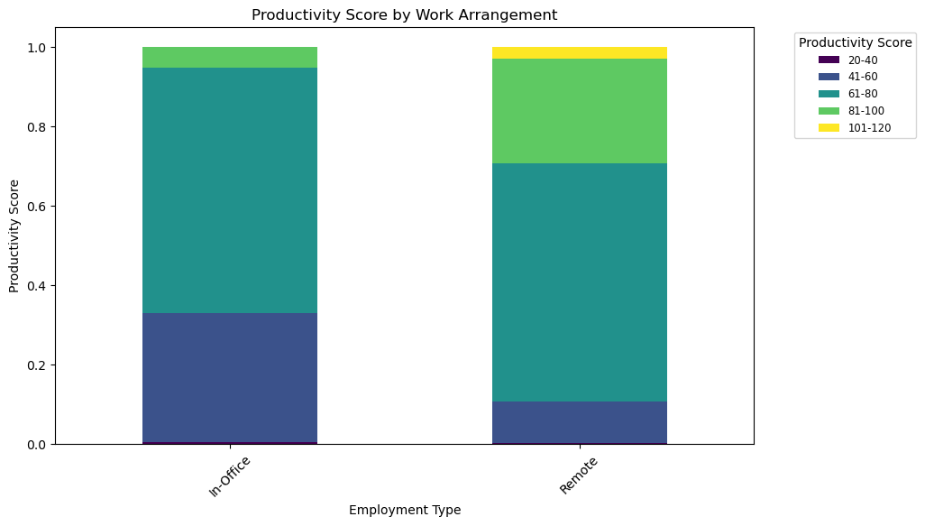
Results - Productivity
Around 60% of the people in both work arrangements have a productivity score of 61-80.
There wasn’t an employee who works in-office with a productivity score higher than 100, unlike those who work remote.
Around 5% of the office employees had a productivity score of 81-100, compared to 25-30% for the remote employees.
Additionally, there were around 30% of the office employees in the 41-60 productivity score threshold and 10% for the remote population.
The mean, mode and median values were 63.77, 63 & 64 for office workers and 73.63, 72 & 73 for remote workers, respectively.
Overall, employees who work remote tend to have higher productivity scores.

Slide 7
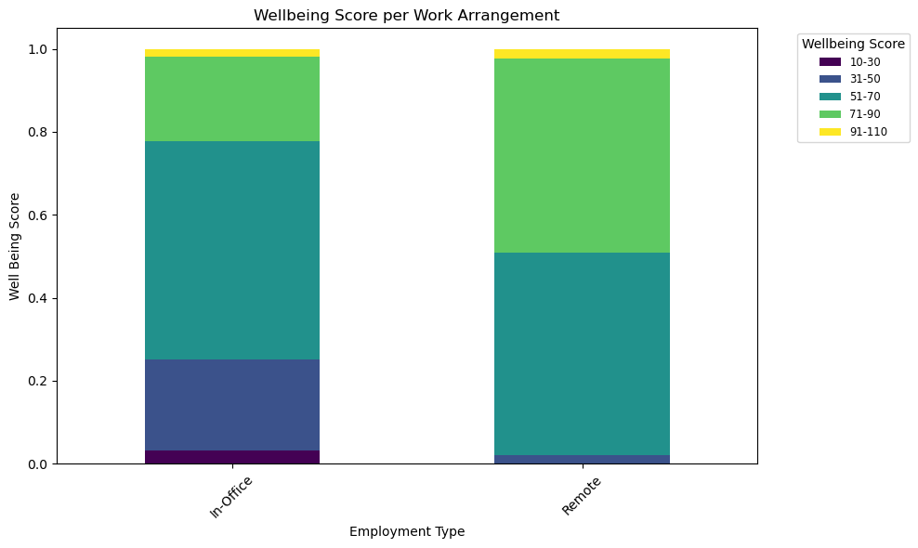
Results - Wellbeing Score
For the highest threshold of the wellbeing score 91-110, there are slightly more remote workers.
~45% of people who work remote have a score of 71-90 compared to 20% for office workers.
Almost a quarter of the office workers have a wellbeing score of less than 50 compared to ~3% for remote workers.
The mean, median and mode values were 58.67, 59.5 & 54 for office workers and 69.49, 69 & 66 for remote workers respectively.
Remote workers have overall higher well being scores.

Slide 8
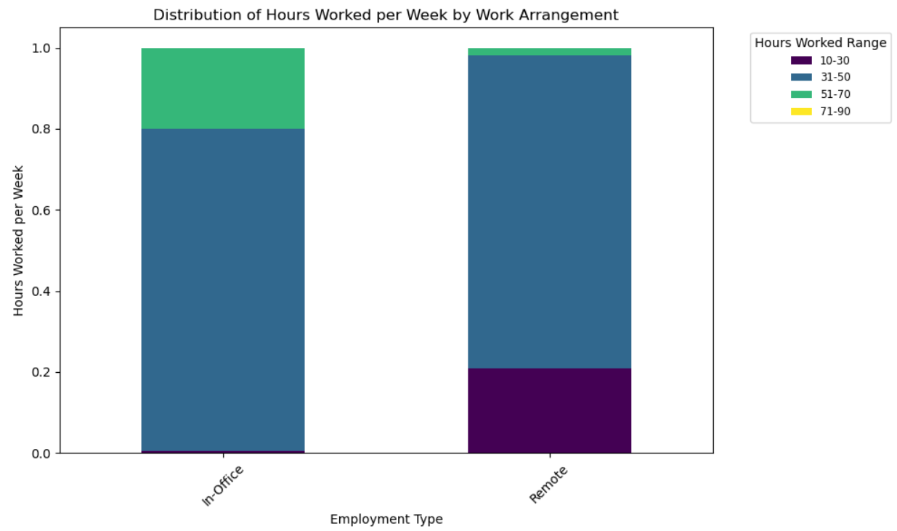
Results - Working Hours
Similarly for both work arrangements ~80% of the employees work 31-50 hours per week.
However, 20% of the remote workers work 10-30 hours per week compared to ~2% for the office workers.
Additionally, 20% of the office workers work 51-70 hours per week, compared to ~2% for remote workers.
The mean, median and mode values were 44.43, 44 & 45 for the office workers and 34.82, 35 & 37 for the remote workers.
Overall, office workers work more hours per week.

Slide 9
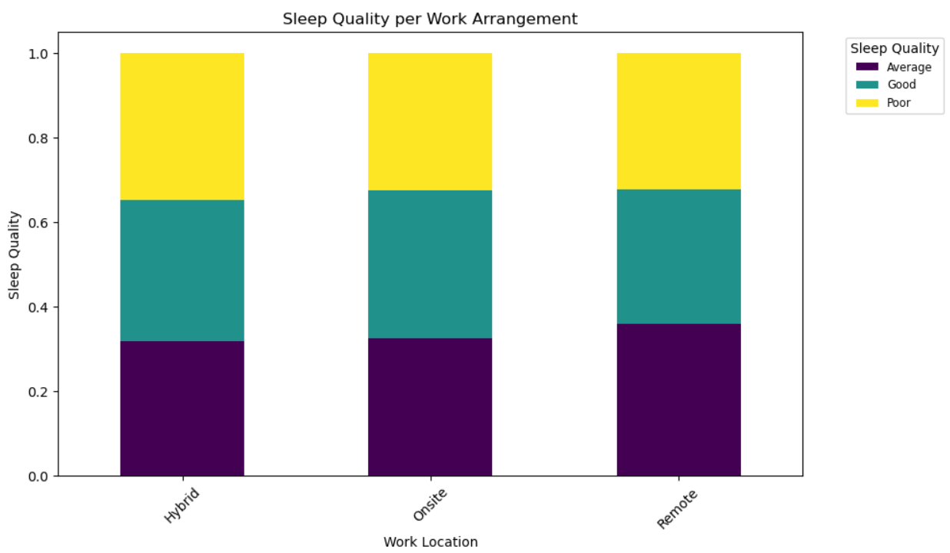
Results - Employee’s Sleep Quality
As this graph was created using the data source “Remote Work and Mental Health”, it includes hybrid workers.
Across hybrid 34.8% of the workers sleep poorly.
Across onsite 34.9% of the workers sleep good.
35.8% of the remote workers sleep average.
Onsite workers have better quality of sleep compared to the other two work arrangements.

Slide 10
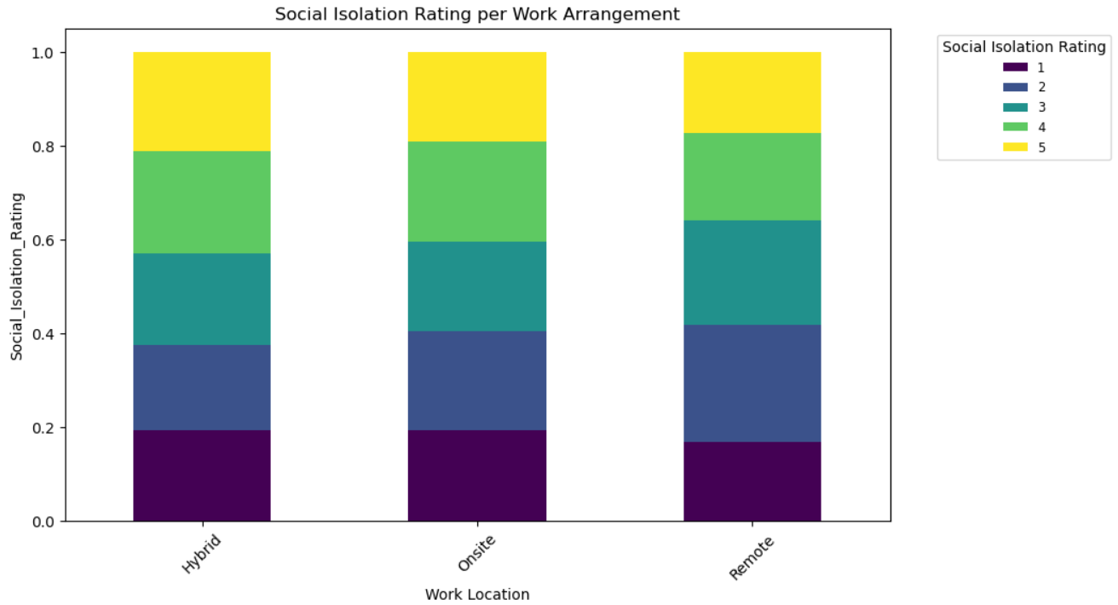
Results - Social Isolation
The mean values for the Social Isolation rating were 3.07, 3.00 & 2.95 for hybrid, onsite and remote respectively.
The median value was 3 for all work arrangements.
The mode values were both 4 for hybrid and onsite and 2 for remote.
Overall, it looks like hybrid employees have a slightly higher rating.

Slide 11
Conclusion
Ultimately, the results of this analysis highlights that workers who work remote are overall more productive in their job, work less hours and have a better wellbeing.
However, onsite employees tend to have better sleep quality compared to hybrid and onsite.
Hybrid employees, appear to have higher social isolation ratings compared to the other two work arrangements.
Hybrid looks to be the “weaker” or “less effective” work arrangement based on the analysis performed on the two specific features that have mostly to do with the wellbeing of the employees.
All in all, it looks like remote workers have an advantage in most features, however it is ultimately up to the employee or the people manager to make their decision based on what their goal, their personal preferences and which one aligns better with their interests.

Slide 12
Sources
“Remote Work & Mental Health” https://www.kaggle.com/datasets/waqi786/remote-work-and-mental-health
“Remote Work Productivity” https://www.kaggle.com/datasets/mrsimple07/remote-work-productivity/data

